Slide 1
Analysis of Farm Scale Strip Trials
Andrew van Burgel
Australasian Applied Statistics Conference
29 November 2022

Slide 2
Content
Basic statistical principles for design and analysis
Application to farm scale strip trials
Traditional analysis methods (ANOVA)
Evaluating Geographically Weighted Regression
Slide 2 of 14

Slide 3
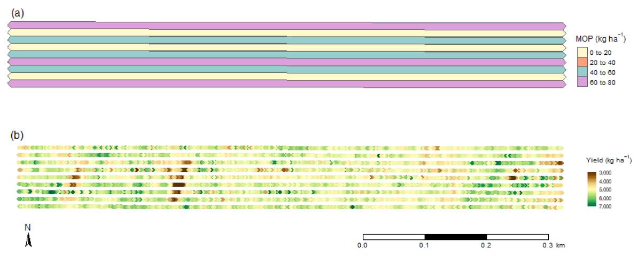
Farm scale strip trials
Evans et al (2020) Assessment of the Use of Geographically Weighted Regression for Analysis of Large On-Farm Experiments and Implications for Practical Application
Example from Evans et al 2020
strips 900m long and 12m wide
3 treatments (Potassium rates) x 3 reps
Typical questions of interest
What is the yield response to treatment and how does the response vary across the paddock?
(Statistician) where is the yield response statistically significant?
Slide 3 of 14

Slide 4
Basic statistical principles for agricultural trials
There is always underlying (spatial) variability
Replication is necessary
to give confidence that treatment effects are real and not due to this variability (statistical significance)
Experimental unit is at the scale treatments are applied.
Replication within the experimental unit can become pseudo (false) replication (giving inflated incorrect significance)
These basic principals should also guide the design and analysis of farm scale strip trials. Otherwise, conclusions may be made based on variability and not real treatment effects.
Slide 4 of 14

Slide 5
Basic statistical principals - example
Randomised block design – 3 reps x 3 treatments = 9 plots
10 plant counts per plot, giving 90 plant counts
Correct analysis:
based on 9 plot averages, not 90 data values
plot is the experimental unit
B | C | A | C | B | A | B | A | C
x
x
x
x
x
x
x
x
x
x
Slide 5 of 14

Slide 6
Application to farm scale strip trials
Design:
encourage a minimum of 2 strips of all treatments, here we have 3 ☺
Analysis:
Standard analysis (e.g. ANOVA) at various locations based on 9 values (nine experimental units)
Combined analysis of multiple locations
a significant location by treatment interaction indicates a spatially varying response
Slide 6 of 14

Slide 7
Geographically Weighted Regression
Evans et al (2020) – “GWR can be simply described as performing local linear regressions, where data are weighted by distance from each local site”
For example, estimation of treatment effect at ‘x’ is based on the yield monitor data surrounding ‘x’ with higher weight for points closer to ‘x’.
Concerns: the treatment effect at ‘x’ is
based on lots of data (say 50 points in a radius of 20m) - pseudo replication?
based largely on the first 3 strips (nearest points) - effectively only a single (true) rep?
x
Slide 7 of 14

Slide 8
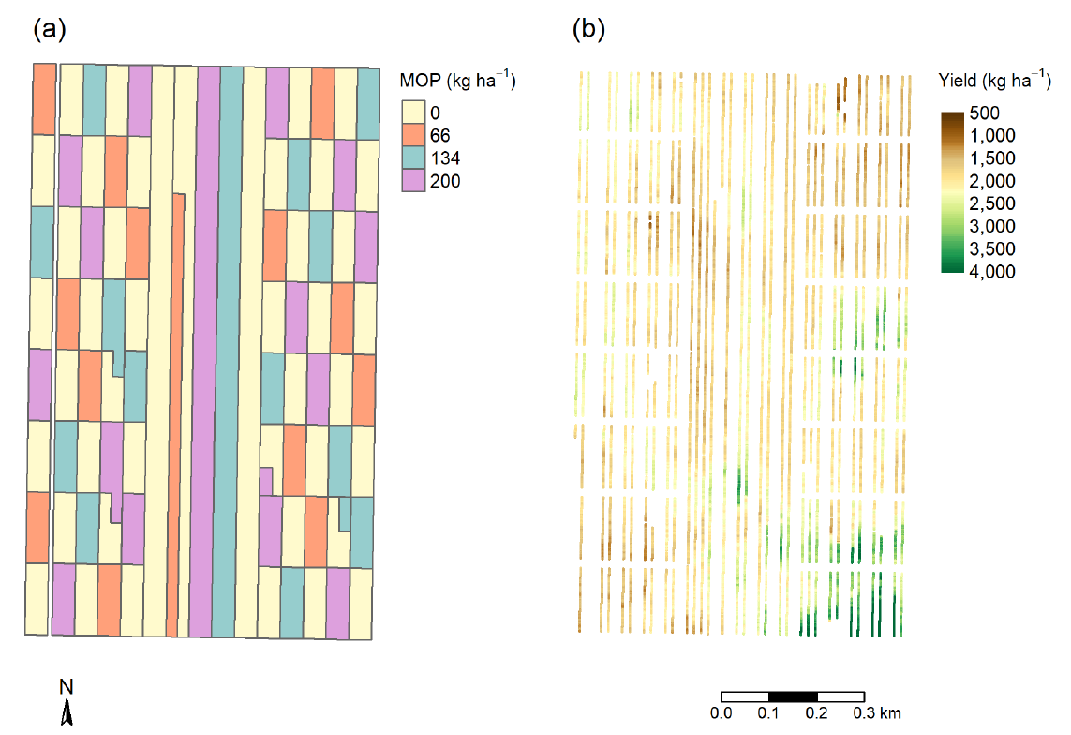
Case study 2 from Evans et al (2020)
Potassium
Fertilizer
(MOP)
Trial
Slide 8 of 14

Slide 9
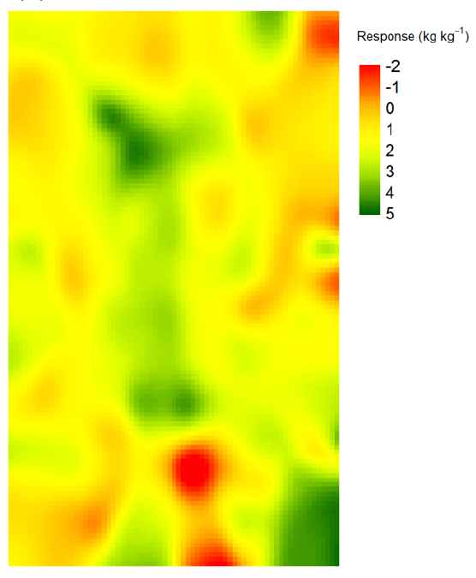
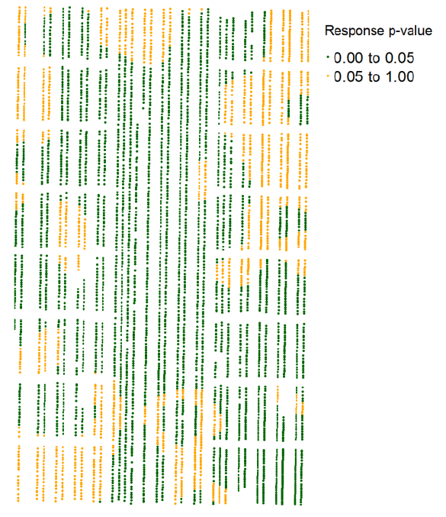
Maximum response 5 kg/ha yield per kg/ha MOP fertilizer
(Economic break-even 7.4)
Response significant (p<0.05) across 75% of the trial area

Slide 10
Case study 2 from Evans et al (2020)
Evans et al (2020) Assessment of the Use of Geographically Weighted Regression for Analysis of Large On-Farm Experiments and Implications for Practical Application
Potassium
Fertilizer
(MOP)
Trial
Slide 10 of 14

Slide 11
Evaluation of Geographically Weighted Regression
Advantages:
Nice graphical display of spatially varying treatment effects
…
Concerns:
Doesn’t reflect basic statistical principles for agricultural trials
Incorrect (inflated) significance due to pseudo replication
Local treatment response is effectively based on a single (true) replication
Therefore, risk that spatial variability appears as treatment responses.
Suggestions going forward:
Until the concerns are resolved, recommend not presenting statistical significance and rather consider large continuous areas of positive treatment effect as a better indicator of statistical significance.
Possible improvement… next slide
Slide 11 of 14

Slide 12
Possible improvement
First average the yield within each strip at a larger distance (around 50m)
This eliminates much of the false replication with each observation more like an experimental unit of the treatment
Estimation of treatment effects may be more evenly based across more treatment strips and thus less influenced by local spatial variation.
x x x x x x x x x x x x x x x x x x x x
x x x x x x x x x x x x x x x x x x x x
x x x x x x x x x x x x x x x x x x x x
x x x x x x x x x x x x x x x x x x x x
x x x x x x x x x x x x x x x x x x x x
x x x x x x x x x x x x x x x x x x x x
x x x x x x x x x x x x x x x x x x x x
x x x x x x x x x x x x x x x x x x x x
x x x x x x x x x x x x x x x x x x x x
Slide 12 of 14

Slide 13
Conclusions
Implementation of Geographically Weighted Regression (GWR) needs to consider the basic statistical principles for agricultural trials
Traditional methods (ANOVA) give reliable results and can provide a valuable comparison to GWR.
Slide 13 of 14

Slide 15
Case of only 1 strip per treatment
Not ideal, but analysis is still possible:
Identify reps separated by sufficient distance to ensure approximately independent comparisons
Why is it not a recommended design?
An error impacting a whole strip (e.g. machine issue or harvest direction effect) will appear as a treatment effect
Less ability to examine spatially varying responses because large distances are required for true replication.
Rep 1
Rep 2
Rep 3
Extra slide

